Slide 1
An Introduction to Software Engineering

Slide 2
Objectives
To introduce software engineering and to explain its importance
To set out the answers to key questions about software engineering
To introduce ethical and professional issues and to explain why they are of concern to software engineers

Slide 3
Topics covered
FAQs about software engineering
关于软件工程的常见问题
Professional and ethical responsibility
专业和道德责任

Slide 4
Software engineering
The economies of ALL developed nations are dependent on software.
More and more systems are software controlled
Software engineering is concerned with theories, methods and tools for professional software development.
Expenditure on software represents a
significant fraction of GNP in all developed countries.
所有发达国家的经济都依赖于软件。
越来越多的系统是软件控制的
软件工程涉及的理论、方法和专业软件开发的工具。
在所有发达国家，软件支出是国民生产总值的一个重要部分。

Slide 5
Software costs软件成本
Software costs often dominate computer system costs. The costs of software on a PC are often greater than the hardware cost.
Software costs more to maintain than it does to develop. For systems with a long life, maintenance costs may be several times development costs.
Software engineering is concerned with cost-effective software development.
软件成本通常在计算机系统成本占主要地位。PC上的软件成本往往大于硬件成本。
软件维护成本比开发成本更大。系统寿命长时,维护成本可能是开发成本的几倍。
软件工程致力于开发具有成本-效益（ cost-effective ）的软件 。

Slide 6
FAQs about software engineering
关于软件工程的常见问题
What is software?
What is software engineering?
What is the difference between software engineering and computer science?
What is the difference between software engineering and system engineering?
What is a software process?
What is a software process model?

Slide 7
FAQs about software engineering
关于软件工程的常见问题
What are the costs of software engineering?
What are software engineering methods?
What is CASE (Computer-Aided Software Engineering)计算机辅助软件工程
What are the attributes of good software?
What are the key challenges facing software engineering?

Slide 8
What is software?什么是软件
Computer programs and associated documentation such as requirements, design models and user manuals.
Software products may be developed for a particular customer or may be developed for a general market.
Software products may be
  Generic - developed to be sold to a range of different customers e.g. PC software such as Excel or Word.
  Bespoke (custom) - developed for a single customer according to their specification.
New software can be created by developing new programs, configuring generic software systems or reusing existing software.
计算机程序和相关的文档,如需求、设计模型和用户手册。
软件产品可能是为特定客户开发或可能为一般的市场开发。
软件产品可能是
  通用的——开出出来卖给不同的客户如电脑软件的Excel或Word。
  定制的——为一个客户，根据他们的规范开发的。
创建新软件，可以通过开发新项目,创建配置通用软件系统或重用现有的软件。

Slide 9
What is software engineering?软件工程
Software engineering is an engineering discipline that is concerned with all aspects of software production.
Software engineers should adopt a systematic and organised approach to their work and use appropriate tools and techniques depending on the problem to be solved, the development constraints and the resources available.
软件工程是一个工程学科,涉及软件生产的各个方面。
软件工程师应该采用一种系统，并组织他们的工作方法和根据要解决的问题使用适当的工具和技术,发展约束和可用的资源。

Slide 10
What is the difference between software engineering and computer science?
软件工程和计算机科学的区别
Computer science is concerned with theory and fundamentals; software engineering is concerned with the practicalities of developing and delivering useful software.
Computer science theories are still insufficient to act as a complete underpinning for software engineering (unlike e.g. physics and electrical engineering).
计算机科学关注的是理论和基础;软件工程关注的是开发的实践性和交付有用的软件。
计算机科学理论仍不足以（ insufficient ）作为软件工程的一个完整的支撑(不像物理和电子工程)。

Slide 11
What is the difference between software engineering and system engineering?
软件工程和系统工程的区别
System engineering is concerned with all aspects of computer-based systems development including hardware, software and process engineering. Software engineering is part of this process concerned with developing the software infrastructure, control, applications and databases in the system.
System engineers are involved in system specification, architectural design, integration and deployment.
系统工程涉及计算机系统开发的各个方面,包括硬件、软件和过程工程。软件工程是这个过程的一部分,涉及开发的软件基础设施, 控制,系统中的应用程序和数据库。
系统工程师参与系统规范,架构设计、集成和部署。

Slide 12
What is a software process?软件过程
A set of activities whose goal is the development or evolution of software.
Generic activities in all software processes are:
  Specification - what the system should do and its development constraints
  Development - production of the software system
  Validation - checking that the software is what the customer wants
  Evolution - changing the software in response to changing demands.
  一组活动的目标是软件的开发或进化。
  在所有软件过程中通用的活动是:
  规范——系统应该做什么和其开发约束
  开发——软件系统的产品
  验证——检查软件是客户想要的东西
  进化——改变软件以应对变化的需求。

Slide 13
What is a software process model?
软件过程模型
A simplified representation of a software process, presented from a specific perspective.
Examples of process perspectives are
  Workflow perspective - sequence of activities;
  Data-flow perspective - information flow;
  Role/action perspective - who does what.
Generic process models
  Waterfall;
  Iterative development;
  Component-based software engineering.
  从特定的角度提出了一个软件过程的简化表示。
  过程的观点的例子：
    工作流的角度——活动序列;
    数据流的角度——信息流;
    角色/行动的角度-谁、做了什么。
  通用过程模型
  瀑布;
  迭代（ Iterative） 开发;
  基于组件的软件工程。

Slide 14
What are the costs of software engineering?
软件工程的成本
Roughly 60% of costs are development costs, 40% are testing costs. For custom software, evolution costs often exceed development costs.
Costs vary depending on the type of system being developed and the requirements of system attributes such as performance and system reliability.
Distribution of costs depends on the development model that is used.
开发成本60%左右,40%的测试成本。定制软件,进化成本往往超过开发成本。
成本取决于系统的类型和系统属性的要求,如性能和系统的可靠性。
分配的成本取决于所使用的开发模型。

Slide 15
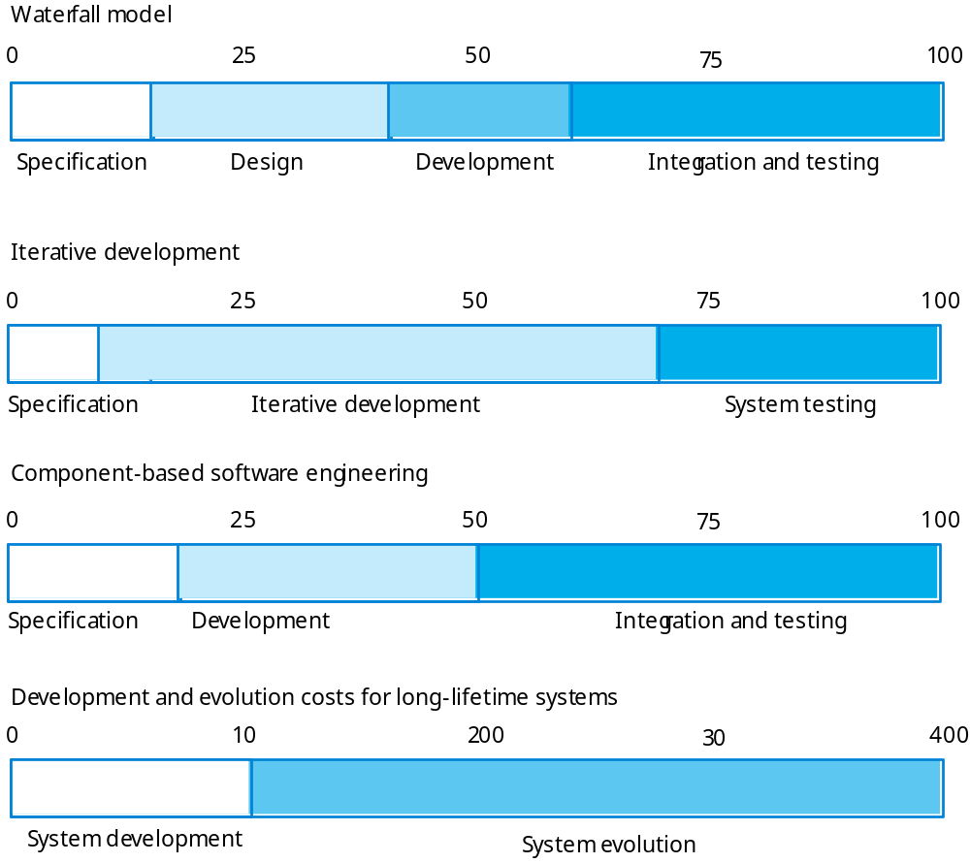
Activity cost distribution活动成本分配

Slide 16
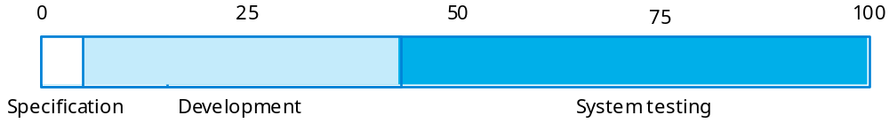
Product development costs产品开发成本

Slide 17
What are software engineering methods?
软件工程方法
Structured approaches to software development which include system models, notations, rules, design advice and process guidance.
Model descriptions
  Descriptions of graphical models which should be produced;
Rules
  Constraints applied to system models;
Recommendations
  Advice on good design practice;
Process guidance
  What activities to follow.
  结构化软件开发方法,包括系统模型、符号、规则、设计建议和过程指导。
  模型的描述
  应该产生图形模型的描述;
  规则
  约束应用的系统模型;
  建议
  良好设计实践的建议;
  过程指导
  遵循什么活动

Slide 18
What is CASE (Computer-Aided Software Engineering)计算机辅助软件工程
Software systems that are intended to provide automated support for software process activities.
CASE systems are often used for method support.
Upper-CASE
  Tools to support the early process activities of requirements and design;
Lower-CASE
  Tools to support later activities such as programming, debugging and testing.
  软件系统,旨在为软件过程活动提供自动化支持。
  计算机辅助软件工程CASE系统通常用于方法的支持。
  上层
  工具来支持需求和设计的早期流程活动;
  下层
  工具来支持以后的活动,如编程、调试和测试。

Slide 19
What are the attributes of good software?
好的软件的属性
The software should deliver the required functionality and performance to the user and should be maintainable, dependable and acceptable.
Maintainability
  Software must evolve to meet changing needs;
Dependability
  Software must be trustworthy;
Efficiency
  Software should not make wasteful use of system resources;
Acceptability
  Software must accepted by the users for which it was designed. This means it must be understandable, usable and compatible with other systems.
  软件应该向用户交付所需的功能和性能,应可维护的,可靠的和可接受的。
  可维护性
  软件必须发展,以满足不断变化的需求;
  可靠性
  软件必须值得信赖;
  有效性
  软件不应该浪费系统资源的使用;
  可接受性
  软件设计出来必须是被用户接受的。这意味着它必须是可以理解的,可用与其他系统兼容。

Slide 20
What are the key challenges facing software engineering?软件工程面临的主要挑战
Heterogeneity, delivery and trust.
Heterogeneity
  Developing techniques for building software that can cope with heterogeneous platforms and execution environments;
Delivery
  Developing techniques that lead to faster delivery of software;
Trust
  Developing techniques that demonstrate that software can be trusted by its users.
  非均质性(多相性)、交付和信任。
  非均质性(多相性)
  为构建软件开发技术,可以处理异构平台和执行环境;
  交付
  开发技术导致更快的交付软件;
  信任
  证明软件可以被用户信任的开发技术。

Slide 21
Professional and ethical responsibility
专业和道德责任
Software engineering involves wider responsibilities than simply the application of technical skills.
Software engineers must behave in an honest and ethically responsible way if they are to be respected as professionals.
Ethical behaviour is more than simply upholding the law.
软件工程有更广泛的责任而不仅仅是技术的应用。
软件工程师必须表现出诚实和道德责任,如果他们是受人尊敬的专业人士。
道德行为更不仅仅是维护法律。

Slide 22
Issues of professional responsibility
职业责任的问题
Confidentiality
  Engineers should normally respect the confidentiality of their employers or clients irrespective of whether or not a formal confidentiality agreement has been signed.
Competence
  Engineers should not misrepresent their level of competence. They should not knowingly accept work which is outwith their competence.
保密
工程人员必须严格保守雇主或客户的机密，而不管是否签署了保密协议
工作能力
工程人员应该实事求是地表述自己的工作能力，不应该接受超出自己能力的工作。

Slide 23
Issues of professional responsibility
Intellectual property rights
  Engineers should be aware of local laws governing the use of intellectual property such as patents, copyright, etc. They should be careful to ensure that the intellectual property of employers and clients is protected.
Computer misuse
  Software engineers should not use their technical skills to misuse other people’s computers. Computer misuse ranges from relatively trivial (game playing on an employer’s machine, say) to extremely serious (dissemination of viruses).
  知识产权
  工程师应该了解有关专利权、著作权等知识产权的地方法律，必须谨慎行事，确保雇主和客户的知识产权收到保护。
  计算机滥用
  软件工程师不应该使用他们的技术技能去滥用别人的计算机。计算机滥用有时候对他人的影响不大(雇主的机器上玩游戏)，但有时候后果极其严重的(传播病毒)。

Slide 24
ACM/IEEE Code of Ethics
ACM和IEEE道德规范
The professional societies in the US have cooperated to produce a code of ethical practice.
Members of these organisations sign up to the code of practice when they join.
The Code contains eight Principles related to the behaviour of and decisions made by professional software engineers, including practitioners, educators, managers, supervisors and policy makers, as well as trainees and students of the profession.
在US的专业团队合作产生一个道德实践的守则。
这些组织的成员加入团队时 签署了职业守则。
守则包含八个原则，针对包括软件工程行业的从业者、教育者、管理者、监督者、政策制定者、接受培训者和学生在内的职业软件工程人员。

Slide 25
Code of ethics - preamble
道德规范——序言
Preamble
  The short version of the code summarizes aspirations at a high level of the abstraction; the clauses that are included in the full version give examples and details of how these aspirations change the way we act as software engineering professionals. Without the aspirations, the details can become legalistic and tedious; without the details, the aspirations can become high sounding but empty; together, the aspirations and the details form a cohesive code.
  Software engineers shall commit themselves to making the analysis, specification, design, development, testing and maintenance of software a beneficial and respected profession. In accordance with their commitment to the health, safety and welfare of the public, software engineers shall adhere to the following Eight Principles:
  软件工程师是致力于做软件的分析、规范 、设计、开发、测试和维护，是一个有益的和受人尊敬的职业。按照致力于公众的健康、安全和福利,软件工程师应当遵守下列八个原则:

Slide 26
Code of ethics - principles
PUBLIC
  Software engineers shall act consistently with the public interest.
CLIENT AND EMPLOYER
  Software engineers shall act in a manner that is in the best interests of their client and employer consistent with the public interest.
PRODUCT
  Software engineers shall ensure that their products and related modifications meet the highest professional standards possible.
  公共感：
  软件工程师应当始终如一地坚持公众利益。
  客户和雇主：
  软件工程师应当采取行动的最好的方式是客户和雇主的利益与公共利益相一致。
  产品：
  软件工程师应确保他们的产品和相关的修改达到最高的专业标准。

Slide 27
Code of ethics - principles
JUDGMENT
  Software engineers shall maintain integrity and independence in their professional judgment.
MANAGEMENT
  Software engineering managers and leaders shall subscribe to and promote an ethical approach to the management of software development and maintenance.
PROFESSION
  Software engineers shall advance the integrity and reputation of the profession consistent with the public interest.
判断力：
软件工程师应当保持完整和独立的专业判断。
管理：
软件工程经理和领导者要制定并促进道德的软件开发和维护的管理方法。
职业感：
软件工程师应当推进 诚信和声誉的符合公共利益的职业。

Slide 28
Code of ethics - principles
COLLEAGUES
  Software engineers shall be fair to and supportive of their colleagues.
SELF
  Software engineers shall participate in lifelong learning regarding the practice of their profession and shall promote an ethical approach to the practice of the profession.
  同事：
  软件工程师应当公正地支持他们的同事。
  自身：
  软件工程师应当参与关于职业的实践的终身学习,促进职业实践的道德方法。

Slide 29
Ethical dilemmas道德困境
Disagreement in principle with the policies of senior management.
Your employer acts in an unethical way and releases a safety-critical system without finishing the testing of the system.
Participation in the development of military weapons systems or nuclear systems.
在原则上与高级管理层的政策存在分歧。
你的雇主有一个不道德的行为，而且没有完成测试就 发表了一个安全关键系统。
参与军事武器系统或核系统的开发。

Slide 30
Key points
Software engineering is an engineering discipline that is concerned with all aspects of software production.
Software products consist of developed programs and associated documentation. Essential product attributes are maintainability, dependability, efficiency and usability.
The software process consists of activities that are involved in developing software products. Basic activities are software specification, development, validation and evolution.
Methods are organised ways of producing software. They include suggestions for the process to be followed, the notations to be used, rules governing the system descriptions which are produced and design guidelines.
软件工程是一个工程学科,涉及软件生产的各个方面。
软件产品包括开发的程序和相关文档。基本产品属性有
可维护性（maintainability 、可靠性 dependability 、效率 efficiency 和可用性usability 。
软件过程由参与开发软件产品的活动组成。基本活动是软件规范,开发,验证和进化。
生产软件的方法是有组织的方式。包括遵循建议的过程,使用的符号,规则产生的系统描述和设计指南。

Slide 31
Key points
CASE tools are software systems which are designed to support routine activities in the software process such as editing design diagrams, checking diagram consistency and keeping track of program tests which have been run.
Software engineers have responsibilities to the engineering profession and society. They should not simply be concerned with technical issues.
Professional societies publish codes of conduct which set out the standards of behaviour expected of their members.
计算机辅助软件工程工具是软件系统,旨在支持软件过程中的日常活动,如编辑设计图,检查图的一致性和跟踪运行项目的测试。
软件工程师要对工程行业和社会负责任。他们不应该只是关心技术问题。
专业协会发布的行为准则，制定的标准行为，是对其成员的期望。

